Slide 1
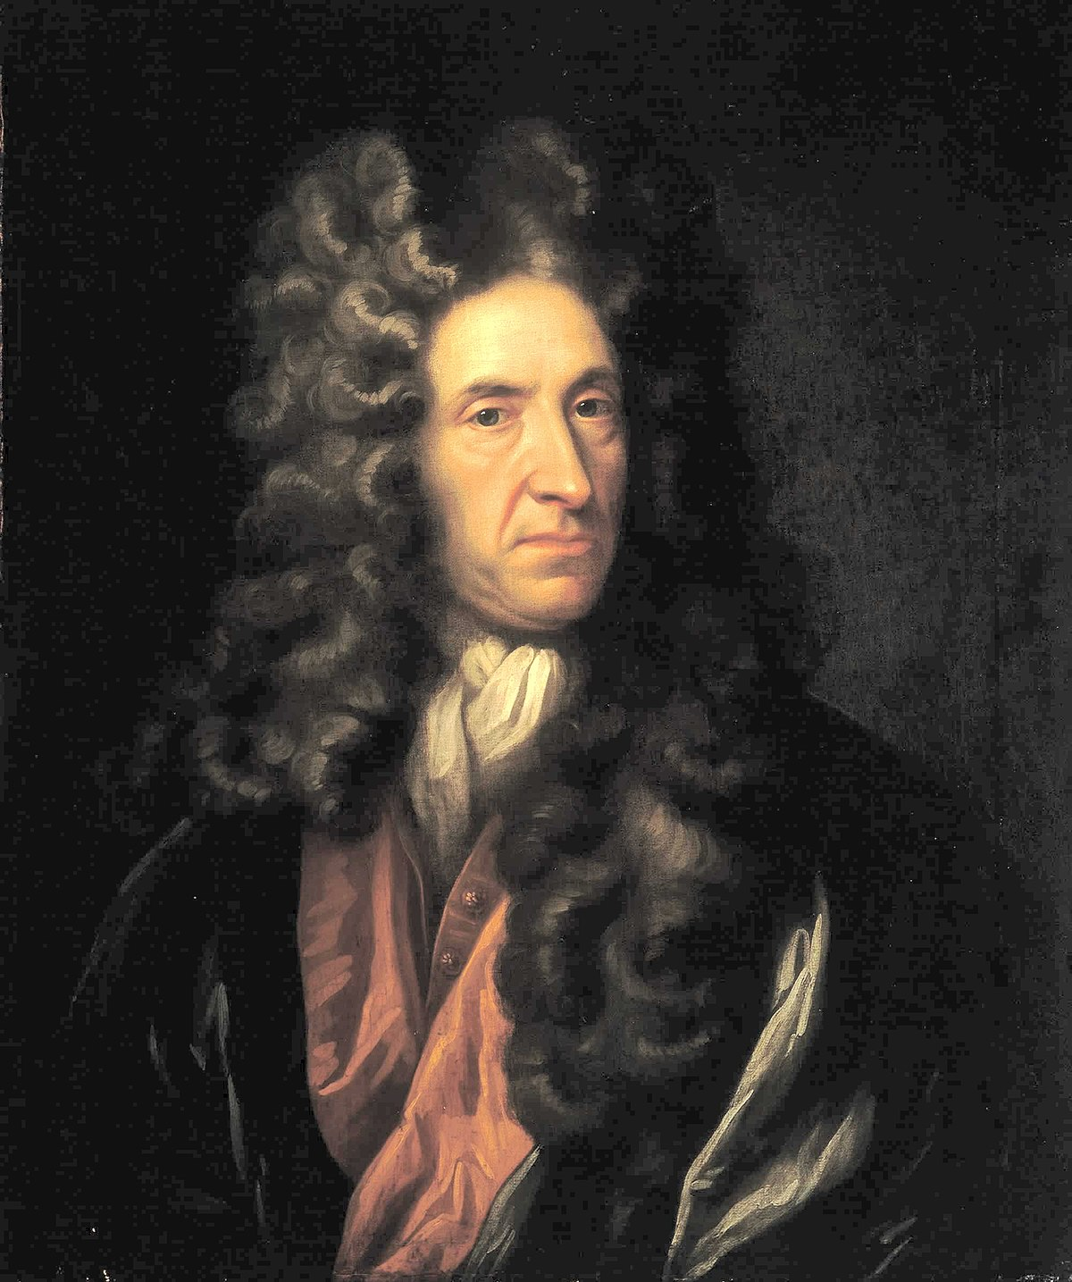
DANIEL DEFOE BECOMING A WRITER JANDA, KEJVAL, HEJHAL

Slide 2
DANIEL DEFOE BECOMING A WRITER JANDA, KEJVAL, HEJHAL
OVERVIEW
DEFOE‘S LIFE
WRITING
ROBINSON CRUSOE

Slide 3
DANIEL DEFOE BECOMING A WRITER JANDA, KEJVAL, HEJHAL
OVERVIEW
DEFOE‘S LIFE
WRITING
ROBINSON CRUSOE
BIRTH AND EDUCATION
LIFE AS A MERCHANT
POLITICAL LIFE
WRITING, REALISM AND NOVEL
ROBINSON CRUSOE
SUMMARY
*Around the year 1660 – 24th of April 1731 in London
Born as Foe, added „De“ later in his life
Sent to academy at Newington Street
Studied theology and learnt multiple languages
Not interested in working at the Church, became a merchant

Slide 4
OVERVIEW
DEFOE‘S LIFE
WRITING
ROBINSON CRUSOE
DANIEL DEFOE BECOMING A WRITER JANDA, KEJVAL, HEJHAL
*Around the year 1660 – 24th of April 1731 in London
Born as Foe, added „De“ later in his life
Sent to academy at Newington Street
Studied theology and learnt multiple languages
Not interested in working at the Church, became a merchant
BIRTH AND EDUCATION
LIFE AS A MERCHANT
POLITICAL LIFE
WRITING, REALISM AND NOVEL
ROBINSON CRUSOE
SUMMARY
Dealt with vine and tobaco, invested in sea shipping
Conflicts with France – damaging trade
1692 – arrested for debts of £700
Total debts - £17 000 –> declaring bankrupt
Release from debt prison –> traveling across Europe

Slide 5
OVERVIEW
LIFE AND EDUCATION
WRITING
ROBINSON CRUSOE
DANIEL DEFOE BECOMING A WRITER JANDA, KEJVAL, HEJHAL
*Around the year 1660 – 24th of April 1731 in London
Born as Foe, added „De“ later in his life
Sent to academy at Newington Street
Studied theology and learnt multiple languages
Not interested in working at the Church, became a merchant
BIRTH AND EDUCATION
LIFE AS A MERCHANT
POLITICAL LIFE
WRITING, REALISM AND NOVEL
ROBINSON CRUSOE
SUMMARY
Dealt with vine and tobaco, invested in sea shipping
Conflicts with France – damaging trade
1692 – arrested for debts of £700
Total debts - £17 000 –> declaring bankrupt
Release from debt prison –> traveling across Europe
1685 – Monmouth Rebellion
1689 – close ally of William III.
Writing political pamphlets and leaflets
1702 – imprisoned for The Shortest Way with the Dissenters
Working for Robert Harley as a reporter
1704 - 1713 –> Magazine „The Review“

Slide 6
OVERVIEW
LIFE AND EDUCATION
WRITING
ROBINSON CRUSOE
DANIEL DEFOE BECOMING A WRITER JANDA, KEJVAL, HEJHAL
*Around the year 1660 – 24th of April 1731 in London
Born as Foe, added „De“ later in his life
Sent to academy at Newington Street
Studied theology and learnt multiple languages
Not interested in working at the Church, became a merchant
Dealt with vine and tobaco, invested in sea shipping
Conflicts with France – damaging trade
1692 – arrested for debts of £700
Total debts - £17 000 –> declaring bankrupt
Release from debt prison –> traveling across Europe
BIRTH AND EDUCATION
LIFE AS A MERCHANT
POLITICAL LIFE
WRITING, REALISM AND NOVEL
ROBINSON CRUSOE
SUMMARY
1685 – Monmouth Rebellion
1689 – close ally of William III.
Writing political pamphlets and leaflets
1702 – imprisoned for The Shortest Way with the Dissenters
Working for Robert Harley as a reporter
1704 - 1713 –> Magazine „The Review“
Middle class oriented
Works prior to creating the novel(The Family instructor; A continuation of the letters written by a Turkish spy)
Father of the novel
The first realist

Slide 7
OVERVIEW
LIFE AND EDUCATION
WRITING
ROBINSON CRUSOE
DANIEL DEFOE BECOMING A WRITER JANDA, KEJVAL, HEJHAL
*Around the year 1660 – 24th of April 1731 in London
Born as Foe, added „De“ later in his life
Sent to academy at Newington Street
Studied theology and learnt multiple languages
Not interested in working at the Church, became a merchant
Dealt with vine and tobaco, invested in sea shipping
Conflicts with France – damaging trade
1692 – arrested for debts of £700
Total debts - £17 000 –> declaring bankrupt
Release from debt prison –> traveling across Europe
1685 – Monmouth Rebellion
1689 – close ally of William III.
Writing political pamphlets and leaflets
1702 – imprisoned for The Shortest Way with the Dissenters
Working for Robert Harley as a reporter
1704 - 1713 –> Magazine „The Review“
BIRTH AND EDUCATION
LIFE AS A MERCHANT
POLITICAL LIFE
WRITING, REALISM AND NOVEL
ROBINSON CRUSOE
SUMMARY
Middle class oriented
Works prior to creating the novel(The Family instructor; A continuation of the letters written by a Turkish spy)
Father of the novel
The first realist
Most famous work; mix of fiction and real events – published in 1719
Follows Crusoe: who runs to the sea, shipwrecks
Inspired by sailor Alexander Selkirk’s real story
Themes: faith, survival, moral growth, Western values
Published as a true story—huge success, shaped adventure genre

Slide 8
OVERVIEW
LIFE AND EDUCATION
WRITING
ROBINSON CRUSOE
DANIEL DEFOE BECOMING A WRITER JANDA, KEJVAL, HEJHAL
BIRTH AND EDUCATION
LIFE AS A MERCHANT
POLITICAL LIFE
WRITING, REALISM AND NOVEL
ROBINSON CRUSOE
SUMMARY
Middle class oriented
Works prior to creating the novel(The Family instructor; A continuation of the letters written by a Turkish spy)
Father of the novel
The first realist
Most famous work; mix of fiction and real events – published in 1719
Follows Crusoe: who runs to the sea, shipwrecks
Inspired by sailor Alexander Selkirk’s real story
Themes: faith, survival, moral growth, Western values
Published as a true story—huge success, shaped adventure genre
Crusoe’s journey reflects Defoe’s own struggles and faith
Explores redemption through suffering
Shows colonial mindset
Deeply personal and moral story beneath the adventure

Slide 9
OVERVIEW
LIFE AND EDUCATION
WRITING
ROBINSON CRUSOE
Most famous work; mix of fiction and real events – published in 1719
Follows Crusoe: who runs to the sea, shipwrecks
Inspired by sailor Alexander Selkirk’s real story
Themes: faith, survival, moral growth, Western values
Published as a true story—huge success, shaped adventure genre
DANIEL DEFOE BECOMING A WRITER JANDA, KEJVAL, HEJHAL
*Around the year 1660 – 24th of April 1731 in London
Born as Foe, added „De“ later in his life
Sent to academy at Newington Street
Studied theology and learnt multiple languages
Not interested in working at the Church, became a merchant
Middle class grounded
Works prior to creating the novel(The Family instructor; A continuation of the letters written by a Turkish spy)
Father of the novel
The first realist
BIRTH AND EDUCATION
LIFE AS A MERCHANT
POLITICAL LIFE
WRITING, REALISM AND NOVEL
ROBINSON CRUSOE
SUMMARY
Dealt with vine and tobaco, invested in sea shipping
Conflicts with France – damaging trade
1692 – arrested for debts of £700
Total debts - £17 000 –> declaring bankrupt
Release from debt prison –> traveling across Europe
1685 – Monmouth Rebellion
1689 – close ally of William III.
Writing political pamphlets and leaflets
1702 – imprisoned for The Shortest Way with the Dissenters
Working for Robert Harley as a reporter
1704 - 1713 –> Magazine „The Review“
Crusoe’s journey reflects Defoe’s own struggles and faith
Explores redemption through suffering
Shows colonial mindset
Deeply personal and moral story beneath the adventure
THANK YOU!

Slide 10
OVERVIEW
LIFE AND EDUCATION
WRITING
ROBINSON CRUSOE
Most famous work; mix of fiction and real events
Follows Crusoe: who runs to the sea, shipwrecks
Inspired by sailor Alexander Selkirk’s real story
Themes: faith, survival, moral growth, Western values
Published as a true story—huge success, shaped adventure genre
BIRTH AND EDUCATION
LIFE AS A MERCHANT
POLITICAL LIFE
WRITING, REALISM AND NOVEL
ROBINSON CRUSOE
SUMMARY
DANIEL DEFOE BECOMING A WRITER JANDA, KEJVAL, HEJHAL
*Around the year 1660 – 24th of April 1731 in London
Born as Foe, added „De“ later in his life
Sent to academy at Newington Street
Studied theology and learnt multiple languages
Not interested in working at the Church, became a merchant
Middle class grounded
Works prior to creating the novel(The Family instructor; A continuation of the letters written by a Turkish spy)
Father of the novel
The first realist
Crusoe’s journey reflects Defoe’s own struggles and faith
Explores redemption through suffering
Shows colonial mindset
Deeply personal and moral story beneath the adventure
Dealt with vine and tobaco, invested in sea shipping
Conflicts with France – damaging trade
1692 – arrested for debts of £700
Total debts - £17 000 –> declaring bankrupt
Release from debt prison –> traveling across Europe
1685 – Monmouth Rebellion
1689 – close ally of William III.
Writing political pamphlets and leaflets
1702 – imprisoned for The Shortest Way with the Dissenters
Working for Robert Harley as a reporter
1704 - 1713 –> Magazine „The Review“
THANK YOU!

Slide 11
BIRTH AND EDUCATION
LIFE AS A MERCHANT
POLITICAL LIFE
WRITING, REALISM AND NOVEL
ROBINSON CRUSOE
SUMMARY
OVERVIEW
LIFE AND EDUCATION
WRITING
ROBINSON CRUSOE
Most famous work; mix of fiction and real events
Follows Crusoe: who runs to the sea, shipwrecks
Inspired by sailor Alexander Selkirk’s real story
Themes: faith, survival, moral growth, Western values
Published as a true story—huge success, shaped adventure genre
DANIEL DEFOE BECOMING A WRITER JANDA, KEJVAL, HEJHAL
*Around the year 1660 – 24th of April 1731 in London
Born as Foe, added „De“ later in his life
Sent to academy at Newington Street
Studied theology and learnt multiple languages
Not interested in working at the Church, became a merchant
Middle class grounded
Works prior to creating the novel(The Family instructor; A continuation of the letters written by a Turkish spy)
Father of the novel
The first realist
Crusoe’s journey reflects Defoe’s own struggles and faith
Explores redemption through suffering
Shows colonial mindset
Deeply personal and moral story beneath the adventure
Dealt with vine and tobaco, invested in sea shipping
Conflicts with France – damaging trade
1692 – arrested for debts of £700
Total debts - £17 000 –> declaring bankrupt
Release from debt prison –> traveling across Europe
1685 – Monmouth Rebellion
1689 – close ally of William III.
Writing political pamphlets and leaflets
1702 – imprisoned for The Shortest Way with the Dissenters
Working for Robert Harley as a reporter
1704 - 1713 –> Magazine „The Review“
THANK YOU!

